Slide 1
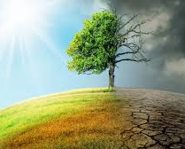
What has already changed in our countries due to global warming?
sweden:focusing more on alternative fuels like bio fuels
sweden and germany: get money back for buying elecrical cars.
Italy: stricter rules about recyceling.

Slide 2
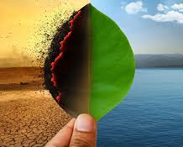
What effects does the climate changes have to the life in your country?
dry and hot weather damage the agriculture=we get less food.
More and more people have stopped eating meat because the meat production contributes to the increesed global warming.

